Slide 1
July 6th, 2016
WiseCore4S architecture lecture 【Structure】
Tomonori Naota / Shuhei Obara, SD 47 , Dept. 42

Slide 2


Self-introduction
Name:
  Shuhei Obara
Organization:
  SD Section 47, R&D Department 42, Software 4 R&D Division, Corporate Software Development Division
Experience:
  2011.11.1 Joins KDC. Assigned to MFP/Printer product development.
  2011.11～2012.6 MFP/Printer Functional design
  2012.7～2013.12
  ・JOB team
  ・Design Member, Task Member (Polaris and ES color printer)
  2014.1～2016.5
  ・System Design (NewA3, 6thPlus, Thread Design and Performance items)
  2016.6～ WiseCore4S architecture development

Slide 3
WiseCore4S architecture lecture Software structure

Slide 4
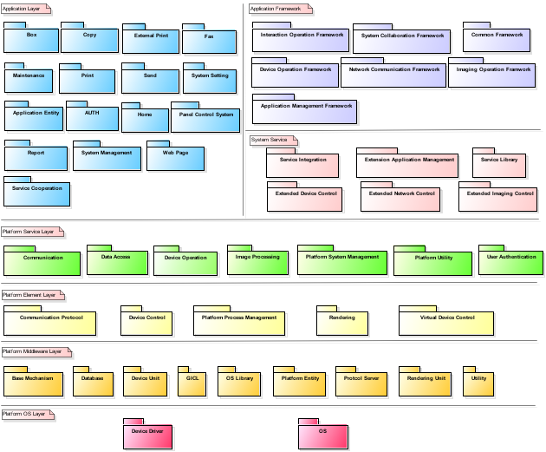
  Subsystem
Application Layer
Extension Service Platform
Application Framework
Standard Applications
System Service Layer
Platform Service Layer
Product Line Platform
Platform Element Layer
Platform Middleware Layer
Platform OS Layer
Notes:
I explain about Subsystem in WiseCore4S.
Sub system is system that is a part of the whole, grouped together by similar features.
Overall the WiseCore4S controller structure consists of Standard application, Product line platform, Extension service platform.
Standard Application is subsystem that realizes standard functions and provides them as the Application Service.
Product Line Platform is subsystem that realizes functions as the basis to serve users and provides them as the Platform Service.
Extension Service Platform is subsystem that provides the means for Extension Application to extend its functions.
WiseCore4Sのサブシステム構成について説明します。
サブシステムとは、システム全体の一部を構成する機能単位で分割されたシステムです。
WiseCore4Sでは、大きく、Standard Applicationと、Product Line Platform、そして、Extension ServicePlatformのサブシステムに分割されます。
Standard Applicationは、標準機能を実現し、アプリケーションサービスとして提供します。
Product Line Platformは、ユーザーサービスを実現するための基盤となる機能を実現します。
Extension Applicationは、拡張機能を実現し、アプリケーションサービスとして提供します。

Slide 5
  Subsystem
Application Layer
Extension Service Platform
Application Framework
Standard Applications
×
System Service Layer
Platform Service Layer
Product Line Platform
×
×
Platform Element Layer
Platform Middleware Layer
Platform OS Layer
Notes:
Product Line Platform provides various functions to generate Standard Application and Extension Applications.
The component in Product Line Platform does not call interface provided from Standard Application and Extension Service Platform.
Because Product Line Platform cannot decide the behavior of Applications.
So dependence from Product Line Platform to Standard Applications and Extension Service Platform is not allowed.
And also dependence from Product Line Platform to Extension Service Platform, From Extension Service Platform to Standard Applications are not allowed.
This sheet shows it.
Regarding a Notification from Product Line Platform to Standard Application, we use observer pattern.
The component in Product Line Platform provides observer interface, and component in Application register observer by using this interface.
By registering observer, Standard Application can receive notification from Product Line Platform.
Next, I explain about package in this subsystem.
Product Line Platformは、Standard Applicationと、Extension Service Platformに機能を提供するサブシステムです。
Product Line Platformから、Standard Applicationと、Extension Service Platformが提供するインタフェースを呼び出してはいけません。
それは、Product Line Platformは、アプリケーションの振る舞いを決めることはできないからです。
そのため、Product Line PlatformからStandard Applicationと、Extension Service Platformに向けての依存関係を持たせてはいけません。
同様のことが、Extension Service Platformと、Standard Applicationにも言えます。Extension Service PlatformからStandard Applicationへの依存
関係を持たせてはなりません。
それをこの図で表現しています。
Product Line PlatformからStandard Applicationへの通知は、オブザーバの仕組みを使用して行います。
Product Line Platformサブシステムに配置されるコンポーネントは、オブザーバインタフェースを提供し、そのインタフェースを利用し、Standard Applicationから
オブザーバを登録することで、Standard Applicationは、Product Line Platformからの通知を受けることができます。
次に、それぞれのサブシステムに配置されるパッケージについて説明します。

Slide 6
  Layers
Application Layer
Application Framework
System Service Layer
Platform Service Layer
Platform Element Layer
Platform Middleware Layer
Platform OS Layer
Notes:
I explain about packages in each layer.
Subsystem of Standard Application does not have layer.
Product Line Platform has 4 layers, Platform Service Layer, Platform Element Layer, Platform Middleware Layer, and Platform OS Layer.
Platform Service Layer provides platform functions to Applications.
Other layer, Platform Element Layer, Platform Middleware Layer, and Platform OS Layer are same as WiseCore3.
Extension Service Platform has 2 layers.
Application Framework Layer provides Application Framework to Extension Applications.
And System Service Layer provides interface for Application Framework,
which is for adjusting difference between Application Framework and Product Line Platform.
Next, I explain about each Layer.
サブシステムに配置されるレイヤと、パッケージについて説明します。
Standard Applicationはレイヤを持ちません。
Product Line Platformは、4つのレイヤで構成されています。
Platform Service Layerが、Standard Application、Extension Service Platformサブシステムに対して、Platformの機能を提供するレイヤとなります。
Extension Service Platformは、2つのレイヤで構成されています。
Application Framework Layerは、拡張アプリケーションに対して、アプリケーションフレームワークを提供するレイヤです。
また、System Service LayerはApplication Frameworkと、Product Line Platform間の機器制約を吸収するレイヤとして定義しています。
次に、各レイヤについて説明します。

Slide 7
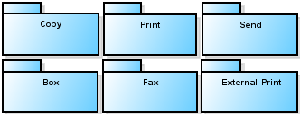





  Application Layer
Application Layer
This layer realizes user services by combining platform services and manages the execution state of these user services.
Basic function applications
System applications
Operation applications
Service cooperation applications
Notes:
This is Application Layer.
This layer Realizes user services by combining platform services and manages the execution state of these user services.
The package in this layer are defined in each Functions.
I divide into 4 categories about these packages, Basic function applications, System applications, Operation applications and Service cooperation applications.
Especially, Basic function application has been defined for each use case.
これはアプリケーションレイヤーです。
Application Layerは、ユーザーに、アプリケーションサービスとして提供するレイヤとなります。
ここに配置されるパッケージは、機能ごとに定義されます。
私たちは、基本機能アプリケーション、システムアプリケーション、操作アプリケーション、サービス連携アプリケーションの4つのカテゴリーに分けました。
特に、Basic function applicationsはユースケースに基づき、分割しています。

Slide 8


  Platform Service Layer
Platform Service Layer
Provides Platform Service I/F for Application Layer.
Notes:
Platform Service Layer provides Platform Service I/F for Application.
Platform Service includes Communication, Data Access, Device Operation, Image Processing, Platform System Management, Platform Utility, and User Authentication.
Platform Service Layerは、Applicationに対して、サービスを提供するレイヤです。

Slide 9


  Platform Element Layer
Platform Element Layer
Provides means to realize platform service.
Provides I/F for the exterior and accepts external requests.
Notes:
Platform Element Layer provides means to realize platform service, and provides I/F for the exterior and accepts external requests.
This layer includes Communication Protocol, Device Control, Rendering, Virtual Device Control, and Platform Process Management.
Platform Element Layerは、プラットフォームサービスを実現する手段を提供するレイヤです。そして、外部向けI/Fの提供と、外部からの要求受付を行います。
このレイヤには、Communication Protocol, Device Control, Rendering, Virtual Device Control, and Platform Process Managementが含まれます。

Slide 10


  Platform Middleware Layer
Platform Middleware Layer
Limits dependency of upper layers on OS.
Notes:
Platform Middleware Layer limits dependency of upper layers on OS, and provides the means to operate devices with standard support,
And manages and keeps the data necessary to realize functions of Product Line Platform, and provides the means to utilize data.
This layer includes OS Library, Base Mechanism, Platform Entity, Database, Device Unit, Protocol Server, Rendering Unit, GICL, and Utility.
Platform Middlewareレイヤは、上位層とOSとの依存関係を分離する、標準サポートするデバイスを操作する手段を提供する、
プロダクトラインプラットフォームの機能を実現するために必要なデータを管理・保持し、そのデータを操作する手段を提供することを行います。
このレイヤには、OS Library, Base Mechanism, Platform Entity, Database, Device Unit, Protocol Server, Rendering Unit, GICL, and Utilityパッケージを含んでいます。

Slide 11
  Process configuration
Standard Applications
Extension Service Platform
App Process Manager
Copy App
System Manager
Send App
Panel Manager
Box App
System Setting App
Fax App
Extension Service System
Print App
Web Page App
Extension Service Process Manager
Maintenance App
AUTH App
External Print App
Home App
Service Cooperation App
Platform Process Manager
Imaging
Communication
Platform System Manager
Printer
Network Server
Network Manager
Device
Device Panel
Panel Browser Proxy
Product Line Platform
Notes:
This is process configuration in WiseCore4S.
Processes in Standard Application are independent process for each function.
Process in Product Line Platform is not changed from WiseCore3.
Process in Extension Service Platform has two processes as standard.
Next, I explain about policy of how to divide processes.
プロセス構成について説明します。
Standard Applicationsのプロセス構成は、機能毎に独立したプロセス構成となります。
Product Line Platformのプロセス構成は、WiseCore3と変更はありません。
Extension Service Platformは、2つのプロセスを標準で備えます。
次にプロセス分けの基準について説明します。

Slide 12
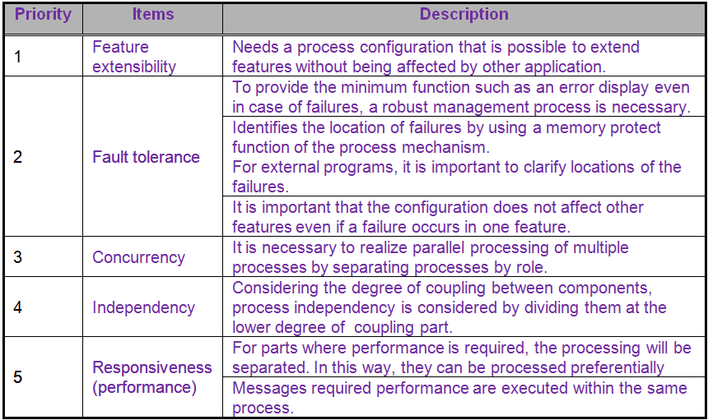
  Process configuration
Notes:
This is policy of how to divide processes.
Policy includes Feature extensibility, Fault tolerance, Concurrency, Independency and Responsiveness.
These items have the priority and Feature extensibility has the highest priority.
これはプロセス分割のための基準です。基準は機能拡張性、耐障害性、並行性、独立性、応答性を含んでいます。
これらの項目は優先度を持っており、機能拡張性が最も優先度が高いです。
優先度 項目 内容
1 機能拡張性 他のアプリケーションの影響を受けることなく、機能拡張可能なプロセス構成が必要です。
2 耐障害性 障害発生時においても、エラー表示など、システムとして最低限の機能を提供するため、堅牢な管理プロセスが必要です。
プロセスメカニズムのメモリ保護機能を利用して問題発生箇所を特定します。特に外部プログラムに関して、切分けを明確にする事が重要です。
ある機能に障害が発生しても、その他の機能に影響を与えない構成にすることが重要です。
3 並行性 役割別にプロセスを独立させることにより、複数プロセスの並行した処理を実現することが必要です。
4 独立性 コンポーネント間の結合度を考慮し結合度の低い部分で分割する事によりプロセスの独立性を考慮します。
5 応答性 (パフォーマンス) パフォーマンスが必要とされる部分は優先的に処理できるように別プロセスとします。
パフォーマンスが要求されるメッセージは同一プロセス内で行います。

Slide 13
END

Slide 14
Reference

Slide 15
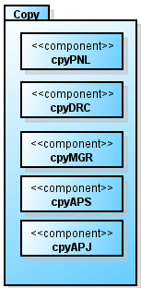
  Application Layer
Basic function application category
Application in this category provides basic function for Service users.
Copy, Send, Box, Fax, Print, External Print, Maintenance
Component name | Abbreviation | WiseCore3 | Background and modification reason of responsibility definition
Copy Panel | cpyPNL | ifsPNL dvcPNL | The obligation of the "Copy" is to create copy screen and accept screen operation of users. The Copy screen generation that was taken up by dvcPNL and acceptance of user operation of copy screen taken up by ifsPNL has been separated and has been consolidated to this component and newly placed.
Copy Application Director | cpyDRC | ifsXXX esvKSF | It has been newly positioned as the component that makes necessary arrangements to perform services offered by Copy package by interpreting various information notified/requested by relevant platforms.
Copy Service Manager | cpyMGR | ifsXXX | This component has been newly placed as a component to accept copy request and manage copy service.
Copy Application Service | cpyAPS | entXXX sysSSM nsvNSV jbmJBMGR dvcPNL | The status and the necessary information of Copy will be managed by Copy. Each component of WC3 that has status management, event transmission/reception and information has been divided by Copy unit, and has been consolidated to this component and has been newly placed.
Copy Application Job | cpyAPJ | usvIMG jbpUSRJB jbmJBMGR dvcPNL | The Job control of Copy will be controlled by Copy. Each component of WC3 that handles Job control has been divided by Copy unit, and has been consolidated to this component and has been newly placed.
Notes:
First, Basic functions applications category.
Application in this category provides basic function for users.
This category includes Copy, Send, Box, Fax, Print, External Print, and Maintenance Application.
Each packages can provide a function for user.
These package has Panel control, Service control, and Job control.
These package have same component structure. And each component has same responsibility.
But these contents of each Application is different.
For example, responsibility of cpyAPS is Service control for Copy function. And also responsibility of sndAPS is Service control for Send function.
基本機能アプリケーションです。
このカテゴリのアプリケーションは、ユーザーに基本機能を提供します。
このカテゴリはCopy, Send, Box, Fax, Print, External Print, and Maintenance Applicationがあります。
それぞれのアプリケーションでユーザーに機能を提供することが可能です。
これらのパッケージには、各機能を実現するためのPanel制御、Service制御、Job制御を行うコンポーネントが含まれています。
基本機能のアプリケーションは、すべてこのようなコンポーネント構成になっています。そして、それぞれのコンポーネントの責務は同じになります。
しかし、各アプリケーションのコンテンツは違っています。
たとえば、CopyアプリケーションのcpyAPSは、Copy機能を実現するためのService制御を行います。
同様にSendアプリケーションのsndAPSは、Send機能を実現するためのService制御を行います。

Slide 16
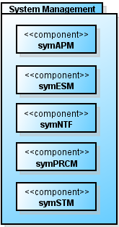
  Application Layer
System application category
Application in this category provides system function for each application.
System Management, Panel Control System, Application Entity, Report, AUTH
Component name | Abbreviation | WiseCore3 | Background and modification reason of responsibility definition
System Process Manager | symPRCM | sysPRCM | Responsibility of system process management has been extracted from sysPRCM and has been newly placed here.
System Energy Saving Manager | symESM | sysESM | Responsibility of energy saving status from sysESM are organized and newly placed here. psmSYM holds the responsibility of power control for each device according to the energy saving status.
System State Manager | symSTM | sysSSM | sysSSM now has in its responsibility; I/F to accept status changes of the overall system, means to change the statues and system status.
System Application Manager | symAPM | - | This component is newly placed to manage the status of each application running as a system.
System Notification | symNTF | nsvNSV | Responsibilities to issue notifications were divided into two components. Application Service component issues a notification if it’s required as a part of one certain Application Service. Conversely, if the system needs to notify its status change, System Notification component bears this responsibility.
Notes:
Next is System applications category.
Application in this category provides system function for each applications.
symPRCM manages processes in Application.
symESM is for energy saving in Application.
sysSTM is for System Status in Application.
symAPM is for managing applications.
次に、システム系アプリケーションです。
このカテゴリのアプリケーションは、各アプリケーションにシステム機能を提供します。
symPRCMは、アプリケーション側のプロセス管理を行うコンポーネントです。
symESMは省エネ状態管理を行うコンポーネントです。
symSTMは、システム状態管理を行うコンポーネントです。
symAPMは、アプリケーションの実行管理を行うコンポーネントです。

Slide 17
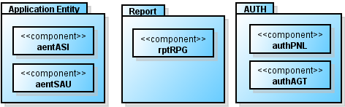
  Application Layer
System application category
Application in this category provides system function for each applications.
System Management, Panel Control System, Application Entity, Report, AUTH
Component name | Abbreviation | WiseCore3 | Background and modification reason of responsibility definition
System Application Utility | aentSAU | utlLIB | Library that is being used by only in application has been extracted from utlLIB and have been newly placed.
Application Service Information | aentASI | entJBINF | This has been placed as a new component to keep necessary information for application.
Report Generator | rptRPG | usvRPG
AUTH Panel | authPNL | ifsPNL dvcPNL | The screen generation of Identity and acceptance of screen operation of the users will be responsibility of Identity. Generation of Identity screen that was taken up by dvcPNL, and acceptance of user operation of Identity screen taken up by ifsPNL has been separated and consolidated to this component and has been newly placed.
AUTH Agent | authAGT | sysAUTH dvcACC | It has been newly positioned as the component that consolidates two separate functions: authentication/authorization and managing information of logged-in users.
Notes:
aentASI provides interface for service information in Application.
rptRPG is for outputing report.
authPNL and authAGT are for Authentication.
aentASIは、ApplicationレイヤでService情報のインタフェースを提供します。
rptRPGは、レポート出力を行うためのコンポーネントです。
authPNLとauthAGTは、認証を行うためのコンポーネントです。

Slide 18
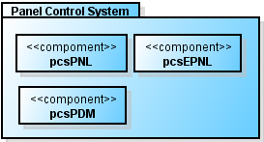
  Application Layer
System application category
Application in this category provides system function for each applications.
System Management, Panel Control System, Application Entity, Report, AUTH
Component name | Abbreviation | WiseCore3 | Background and modification reason of responsibility definition
Panel Control System Panel | pcsPNL | ifsPNL dvcPNL | Panel Control System will be responsible for generating the screens shared by the entire system and accepting screen operation of users. These separate responsibilities (generating the screens shared by the entire system by dvcPNL and accepting screen operation of users by ifsPNL) have been combined into this new component.
Expand Panel | pcsEPNL | ifsPNL dvcPNL | Panel Control System will be responsible for generating the screens for extended features and accepting screen operation of users. These separate responsibilities (generating the screen for extended features by dvcPNL and accepting screen operation of users by ifsPNL) have been combined into this new component.
Panel Display Manager | pcsPDM | ifsPNL dvcPNL | It has been newly positioned as the component that keeps information needed to display screens on panel, and determines whether the system can go back and forth across functions.
Notes:
This is Panel Control system.
This package provide function to control panel in whole system.
pcsEPNL changes the screen displayed on device panel to correspond with the actual system status and keys pressed on the screen relevant to extended functions.
Panel Control Systemです。
このパッケージは、各アプリケーションのパネルコンポーネントをコントロールするなど、システム全体としてのパネル制御を行います。
pcsEPNLは拡張機能に関する画面でのキー押下やシステム状態に応じて、パネルデバイス画面を遷移させます。

Slide 19
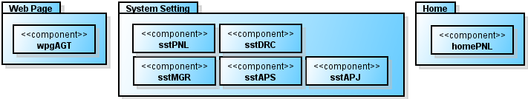
  Application Layer
Operation application category
Application in this category provides various operations for users.
WebPage, System setting, Home
Component name | Abbreviation | WiseCore3 | Background and modification reason of responsibility definition
Web Page Agent | wpgAGT | ifsEWEB | This has been newly placed as component that processes WebPage request.
Home Panel | homePNL | ifsPNL dvcPNL | Panel Control System will be responsible for generating Home screens and accepting screen operation of users. These separate responsibilities (generating Home screen by dvcPNL and accepting screen operation of users by ifsPNL) have been combined into this new component.
Notes:
Next is Operation application category.
This category includes Web page, Home, System Setting package.
Web Page Package provides CCRX function.
Home Application provides Home screen function.
System Setting Package provides System setting function.
次に、Operation application categoryです。
このカテゴリにはWeb page, Home, System Setting packageがあります。
Web Page ApplicationはCCRX機能を提供します。
Home ApplicationはHome画面機能を提供します。
System Setting PackageはSystem設定機能を提供します。

Slide 20
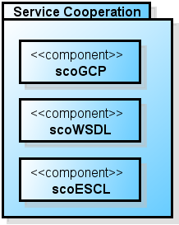
  Application Layer
Service cooperation application category
This application provides services that can be integrated with other services.
Service Cooperation
Component name | Abbreviation | WiseCore3 | Background and modification reason of responsibility definition
Google Cloud Print | scoGCP | - | It has been newly positioned as the component that provides the functions relevant to Google Cloud Print.
Notes:
Finally in Application layer, this is service cooperation application category.
This application provides services that can be integrated with other services.
These component use function provided by basic function application, and provide as new function.
Next I explain about Platform Service layer.
最後に、サービス連携アプリケーションです。
このアプリケーションは、他のアプリケーションを連携することで機能を提供することができるアプリケーションです。
これらのコンポーネントは基本機能アプリケーションによって提供される機能を使用し、新機能を提供します。
次に、PlatformServiceレイヤについて説明します。

Slide 21
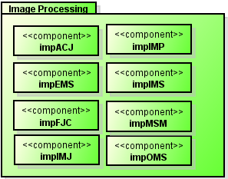
  Image Processing Package
Image Processing
Provides structure for Image Processing service.
Component name | Abbreviation | WiseCore3 | Background and modification reason of responsibility definition
Image Processing Platform Service | impIMP | - | New
Image Job | impIMJ | jbpIMGJB | No change except the abbreviated name.
Access Job | impACJ | jbpACSJB | No change except the abbreviated name.
Mission Manager | impMSM | jbmJBMGR | Responsibility of managing InputMission, EditMission OutputMission has been extracted from jbmJBMGR.
Input Mission | impIMS | impIMS | Responsibility to instruct document editing to next step has been separated from impIMS. Only other change is the abbreviated name.
Edit Mission | impEMS | impEMS | No change
Output Mission | impOMS | impOMS | No change
Fax Job Control | impFJC | jbmFJC | No change except the abbreviated name.
Notes:
Image Processing package provides structure for Image Processing service.
This package includes these components.
impMSM manages the mission components.
impMSM manages the number of Input Mission, Edit Mission, and Output Mission started inside of the WiseCore4S controller system.
And impMSM controls the processing order of each Mission.
Image Processingパッケージは画像処理における仕組みを提供するパッケージです。
このパッケージには、これらのコンポーネントが含まれています。
impMSMはMission管理を行い、WiseCore4Sコントローラシステム内部で起動しているInput Mission、Edit Mission、Output Missionの起動数を管理します。
また、各Missionの処理順序を制御します。

Slide 22
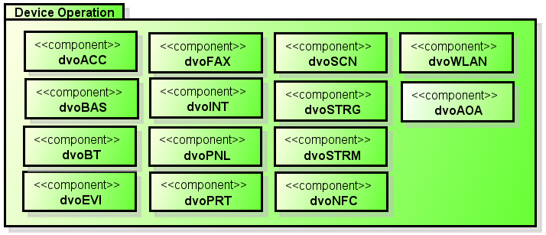
  Device Operation Package
Device Operation
Provides structure for device operation and panel display.
Component name | Abbreviation | WiseCore3 | Background and modification reason of responsibility definition
Scan Device Platform Service | dvoSCN | - | New
Print Device Platform Service | dvoPRT | - | New
Storage Platform Service | dvoSTRG | - | New
Fax Device Platform Service | dvoFAX | - | New
Account Device Platform Service | dvoACC | - | New
Stream Platform Service | dvoSTRM | - | New
Panel Device Platform Service | dvoPNL | - | New
External Video Input Platform Service | dvoEVI | - | New
Bluetooth Device Platform Service | dvoBT | ifsRMNT usvMNT ntcBTSPP | New
Basic Device Platform Service | dvoBAS | - | New
Interpretation Platform Service | dvoINT | - | New
Notes:
Device Operation package provides structure for device operation and panel display.
This package provides interface for device operation, which is changed for using easily in Application.
Device Operationパッケージは、デバイス操作の仕組みを提供するパッケージです。
このパッケージは、主にElement層に配置されるDevice Controlの操作の内、アプリケーション側で使用するインタフェースを公開しています。

Slide 23
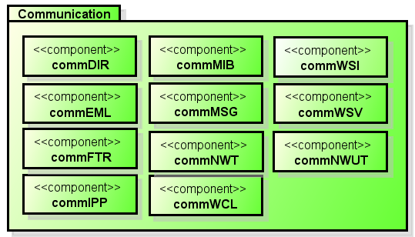
  Communication Package
Communication
Provides application layer with structure for communication with MFP external systems.
Component name | Abbreviation | WiseCore3 | Background and modification reason of responsibility definition
Email Platform Service | commEML | ifsEMAIL / ntcEMAIL | New
IPP Platform Service | commIPP | ifsIPP / ntcIPP | New
Web Server Interface Platform Service | commWSI | ifsEWEB / ntcHTTP | New
Web Client Platform Service | commWCL | usvMNT / ntcHTTP ifsSOAP | New
Web Service Platform Service | commWSV | ifsSOAP / ntcSOAP | New
Network Time Platform Service | commNWT | ntcSNTP | New
Directory Access Platform Service | commDIR | ntcLDAP | New
File Transfer Platform Service | commFTR | ntcFTRANS | New
Messaging Platform Service | commMSG | ifsRMNT / usvMNT ntcXMPP | New
MIB Platform Service | commMIB | ifsSNMP / entMIB ntcSNMP | New
Notes:
Communication package provides application layer with structure for communication with MFP external systems.
This Package has these components.
Communicationパッケージは、MFP外部システムとの通信の仕組みを提供するパッケージです。
このパッケージには、これらのコンポーネントが含まれます。

Slide 24
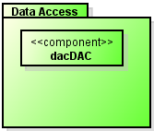
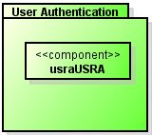
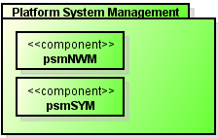
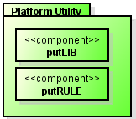
  Other Packages in Platform Service Layer
Data Access
Provides structure for Data operation/Reference/Setting.
Platform System Management
Manages device and network states.
User Authentication
Provides structure for authentication and authorization.
Platform Utility
Provides application layer and product line platform with useful features to be used in the platform and application in common.
Component name | Abbreviation | WiseCore3 | Background and modification reason of responsibility definition
Data Access Platform Service | dacDAC | - | New
User Authentication Platform Service | usraUSRA | sysAUTH | This newly positioned component assumes the responsibilities formerly assumed by sysAUTH: processing user authentication in various ways and controlling authenticated users' status.
System Management Platform Service | psmSYM | sysESM sysSSM | Responsibility related to device control has been extracted from sysESM and has been newly created.
Network Manager | psmNWM | sysNWM | No change except the abbreviated name.
Utility Library Service | putLIB | utlLIB | Library that is being used both by application and platform has been extracted from utlLIB, and has been newly added.
Utility Rules Service | putRULE | utlRULE | The condition judgment of prohibition used both by application and platform has been extracted from utlRULE and has been newly added.
Notes:
Data Access package provides structure for Data operation/Reference/Setting.
This package provides interface to access each Entity for Application Layer.
User Authentication provides structure for authentication and authorization.
Platform System Management manages device and network states.
This package has psmSYM which is for Energy saving and Event handling.
This component communicate with symESM and symSTM in Application side.
And also this package has psmNWM which is for Network management
Platform Utility provides application layer and product line platform with functions to be used in the platform and application in common.
This Package has putLIB and puｔRULE component.
Next is Element Layer.
DataAccessパッケージは、データ操作、参照、設定の仕組みを提供するパッケージです。
このパッケージはアプリケーションレイヤーに各EntityにアクセスするためのI/Fを提供します。
User Authenticationパッケージは、認証認可における仕組みを提供するパッケージです。
Platform System Managementパッケージは、デバイス、ネットワークの状態を管理するパッケージです。
このパッケージは、psmSYMコンポーネントが所属します。このコンポーネントは、省エネ、イベント処理を行います。
このコンポーネントはアプリケーション側のsymESMとsymSTMと連携します。
そして、このパッケージにはネットワークを管理するpsmNWMも含まれます。
Platform Utilityパッケージは、アプリケーションで使用するユーティリティ機能を提供するパッケージです。
このパッケージには、putLIBとputRULEコンポーネントがあります。
次に、Elementレイヤの説明を行います。

Slide 25
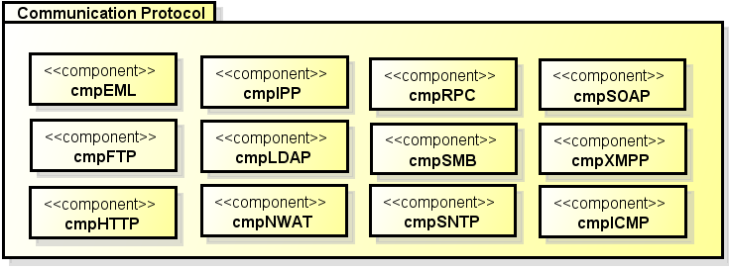
  Communication Protocol Package
Communication Protocol
Provides necessary means to process communication.
Component name | Abbreviation | WiseCore3 | Background and modification reason of responsibility definition
SOAP | cmpSOAP | ntcSOAP | No change except the abbreviated name.
SMB | cmpSMB | ntcFTRANS | The responsibilities of ntcFTRANS were divided into two newly positioned components.
FTP | cmpFTP | ntcFTRANS | The responsibilities of ntcFTRANS were divided into two newly positioned components.
LDAP | cmpLDAP | ntcLDAP | No change except the abbreviated name.
SNTP | cmpSNTP | ntcSNTP | No change except the abbreviated name.
NWAT | cmpNWAT | ntcNWAT | No change except the abbreviated name.
HTTP | cmpHTTP | ntcHTTP | No change except the abbreviated name.
Email | cmpEML | ntcEMAIL | No change except the abbreviated name.
RPC | cmpRPC | ntcRPC | No change except the abbreviated name.
XMPP | cmpXMPP | ntcXMPP | No change except the abbreviated name.
IPP | cmpIPP | ntcIPP | No change except the abbreviated name.
Notes:
Communication Protocol package provides necessary means to process communication.
This Package has some component for each network protocol.
Communication Protocolパッケージは、通信処理のために必要な手段を提供します。
ネットワークプロトコル毎にコンポーネントが定義されています。

Slide 26
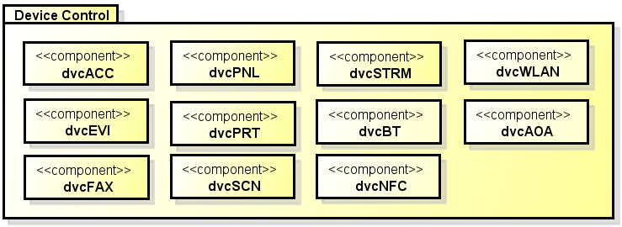
  Device Control Package
Device Control
Provides operation based on the performance specification of each device.
And controls devices logically.
Component name | Abbreviation | WiseCore3 | Background and modification reason of responsibility definition
Scan Control | dvcSCN | dvcSCN | No change.
Panel Control | dvcPNL | dvcPNL | Responsibility to generate screen has been separated from dvcPNL. The responsibility to generate screen of WiseCore3dvcPNL has been passed on to Application layer component. There is no other change.
AccountDevice Control | dvcACC | dvcACC | Responsibility of demanding request has been separated from dvcACC. There is no other change.
Print Control | dvcPRT | dvcPRT dvcEPRT | dvcEPRT has been integrated to dvcPRT. There is no responsibility change.
Fax Control | dvcFAX | dvcFAX | No change.
Stream Control | dvcSTRM | dvcSTRM | No change.
External Video Input Device Control | dvcEVI | dvcEVI | No change.
Notes:
Device Control package provides operation based on the control specification of each device, and controls the devices logically.
This Package has some components for each device, Scanner, Panel, Account Device, Print Engine, Stream, and External Video Input Device.
Device Controlパッケージは、機器の制御仕様に基づき、機器を操作する手段を提供します。
Scanner、PrintEngine、Fax、Stream、AccountDevice、Panelのコンポーネントが定義されています。

Slide 27
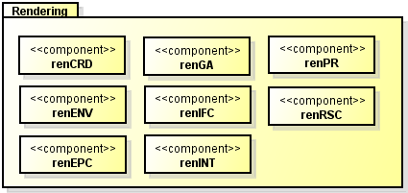
  Rendering Package
Rendering
Provides necessary means to process images (compression, decompression, rotation).
Component name | Abbreviation | WiseCore3 | Background and modification reason of responsibility definition
PDL Interpreter | renINT | renINT | No change.
Graphics Analyzer | renGA | renGA | No change.
Rendering Coordinator | renCRD | renCRD | No change.
Rendering Environment | renENV | renENV | No change.
Primitive Renderer | renPR | renPR | No change.
Rendering Resource | renRSC | renRSC | No change.
Image Format Converter | renIFC | renIFC | No change.
Edit Page Creator | renEPC | renEPC | No change.
Notes:
Rendering package provides necessary means to process images. (compression, decompression, rotation, and so on.)
This Package has some component for each image processing, PDL Interpreter, Image Format Converter, Edit Page Creator, and so on.
Renderingパッケージは、イメージ処理のために必要となる手段を提供します。
PDL Interpreter（renINT）、Image Format Converter(renIFC）、 Edit Page Creator(renEPC)などのコンポーネントが定義されています。

Slide 28
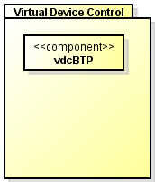
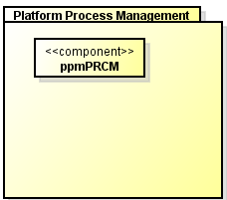
  Other Packages in Platform Element Layer
Virtual Device Control
Provides the framework and means to operate virtual devices.
Platform Process Management
Manages platform process..
Component name | Abbreviation | WiseCore3 | Background and modification reason of responsibility definition
Bluetooth Profile | vdcBTP | ntcBTSPP | Bluetooth of virtual device has been extracted from Network Communication, and has been created into new package and placed here. No other change except the abbreviated name has been made.
Process Manager | ppmPRCM | sysPRCM | Responsibility to manage the platform process has been extracted from sysPRCM and placed here.
Notes:
Virtual Device Control package provides the framework and the means to operate virtual devices.
Virtual Device means profile like an Bluetooth profile, which is not for particular device.
Platform Process Management package manages platform process..
This package has ppmPRCM. ppmPRCM. is for Platform side.
Next I explain about Middleware layer.
Virtural Device Controlパッケージは、仮想デバイスを操作する仕組みを提供します。
仮想デバイスは、特定のデバイスを制御するものではなく、そのデバイスが使用する制御規格を示します。
その一例として、BluetoothのProfileがあります。
Platform Process Managementパッケージは、プラットフォームのプロセスを管理します。
次に、Middlewareレイヤについて説明します。

Slide 29
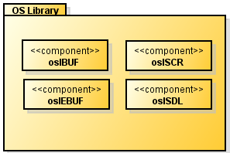
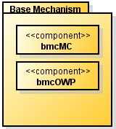
  OS Library and
  Base Mechanism Package
OS Library
Provides the operational means in order to use the technological elements that are directly connected to OS base element.
Base Mechanism
Provides the basic structure and mechanism element as architectural mechanism to the whole system.
Component name | Abbreviation | WiseCore3 | Background and modification reason of responsibility definition
Security | oslSCR | oslSCR | Added oslMDEV's securitykit, activation and satahcutil（encryption logic) to WC3's oslSCR.
Buffer Management | oslBUF | oslBUF | No change.
System Device Logic | oslSDL | oslMDEV | The logic of system device operation has been separated from osIMDEV that provides I/F that uses mixed devices, and placed here. *The following Mdev in WiseCore3 corresponds: osl_mdev_coltbl_dev osl_mdev_iomem osl_mdev_upd osl_mdev_rpcode
External Buffer Management | oslEBUF | oslEXBUF | No change.
Mechanism | bmcMC | bmcMC oslDIC | No change.
OS Wrapper | bmcOWP | bmcOWP | No change.
Notes:
OS Library package provides the operational means in order to use the technological elements that are directly connected to OS base element.
oslSDL provides System Device Logic. These are firmware update, time-zone setting, and so on.
oslSCR provides Security logic. These are security kit, activation, encryption logic and so on
Base Mechanism package provides the basic structure and mechanism element as architectural mechanism to the whole system.
OS Libraryパッケージは、OS基盤要素に直結した技術要素を利用するための操作手段を提供します。
olsSDLは、FW-Update、タイムゾーン設定インタフェースなど、システムロジック制御処理を提供します。
oslSCRは、securitykit、activation、暗号化など、セキュリティロジックを提供します。
Base Mechanisimパッケージは、アーキテクチャーメカニズムとしての基本的な仕組みや、仕掛けのメカニズム要素をシステム全体に提供します。

Slide 30
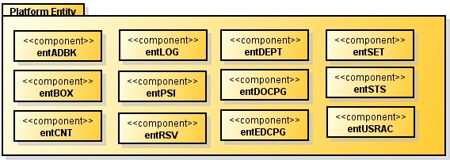
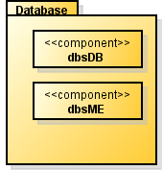
  Platform Entity and Database Package
Platform Entity
Manages and holds the data related to platform, provides data operation
Database
Provides the means to manage data.
Component name | Abbreviation | WiseCore3 | Background and modification reason of responsibility definition
Platform Service Information | entPSI | entJBINF | Information necessary for the performance of the platform is assembled and newly deployed.
Document Box | entBOX | entBOX | The responsibility for information managed by the feature is transferred to each package of the Application Layer. There is no other responsibility change.
User Account | entUSRAC | entUSRAC
Reservation | entRSV | entRSV
Log | entLOG | entLOG
System Status | entSTS | entSTS
System Setting | entSET | entSET
Counter | entCNT | entCNT
Document Page | entDOCPG | entDOCPG
Department | entDEPT | entDEPT
External Document Page | entEDCPG | entExDOCPG
Address Book | entADBK | entADBK
MFP Entity | dbsME | dbsME | No change.
DB | dbsDB | dbsDB | No change.
Notes:
Platform Entity package manages and holds the data related to platform, provides data operation.
Database package provides the means to manage data.
Plafform Entityパッケージは、プラットフォームに関連するデータ管理、保持、そしてそのデータ操作を提供するパッケージです。
Databaseパッケージは、Entityで扱うデータの管理手段を提供しています。

Slide 31
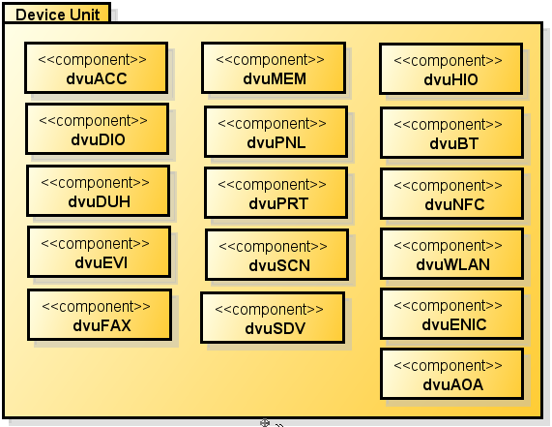
  Device Unit Package
Device Unit
Provides concrete means to operate devices.
Component name | Abbreviation | WiseCore3 | Background and modification reason of responsibility definition
Scan Unit | dvuSCN | dvuSCN | No change.
Print Unit | dvuPRT | dvuPRT / dvuEPRT | dvuEPRT has been integrated to dvuPRT. No change in responsibility.
Fax Unit | dvuFAX | dvuFAX | No change.
Host IO Unit | dvuHIO | dvuHIO | No change.
Account Device Unit | dvuACC | dvuACC | No change.
Disk IO Unit | dvuDIO | dvuDIO | No change. Add requirement of osl_mdev_mount.
Panel Unit | dvuPNL | dvuPNL | No change.
External Video Input Device Unit | dvuEVI | dvuEVI | No change.
Memory Unit | dvuMEM | oslMDEV | Memory devices were collectively separated from osIMDEV that provides I/F that uses mixed devices, and placed here. *The following Mdev in WiseCore3 corresponds: env_oplt_eprom / osl_mdev_memchk / osl_mdev_sanitization flash / env_oplt_flash、env_nvram_write / osl_mdev_amc / osl_mdev_env
Detectable Unit Handler | dvuDUH | oslMDEV | The detachable devices were collectively separated from osIMDEV that provides I/F that uses mixed devices, and placed here. *The following Mdev in WiseCore3 corresponds osl_mdev_event_q（including dvuOBS）/ osl_mdev_usbtest / libUSBKuio
System Device Unit | dvuSDV | oslMDEV | The system devices were collectively separated from osIMDEV that provides I/F that uses mixed devices, and placed here. *The following Mdev in WiseCore3 corresponds: osl_mdev_esu_gpio_api / osl_mdev_gpio / osl_mdev_pmd / osl_mdev_ostask / osl_mdev_timezone / osl_mdev_rtc / osl_mdev_sysclk / osl_mdev_ethernet_api
Notes:
Device Unit package provides concrete means to operate devices.
This Package has components for each device, Scanner, Panel, Account Device, Print Engine, Stream, and so on.
Device Unitパッケージは、デバイスを操作する具体的な手段を提供するパッケージです。
Scanner、Print Engine、Fax、Panelなど、デバイス毎のコンポーネントが配置されます。

Slide 32
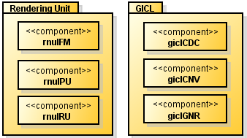
  Rendering Unit and GICL Package
Rendering Unit
Provides means to operate the device necessary for processing images.
GICL
Provides controlling means for hardware logic that is related to image processing and means for operating software logic.
Component name | Abbreviation | WiseCore3 | Background and modification reason of responsibility definition
Image Flow Manager | rnuIFM | renIFM | Since there is access from Platform Middleware Layer, it has been extracted from Rendering and placed in this package. No other changes except the abbreviated name has been made.
Image Rendering Unit | rnuIRU | renIRM | Since there is access from Platform Middleware Layer, it has been extracted from Rendering and placed in this package. No other changes except the abbreviated name has been made.
Image Printing Unit | rnuIPU | dvuPRT dvuEPRT | This newly defined component partly takes over the responsibility of dvuPRT component, so that it now assumes the responsibility of image processing triggered by operating a device.
Codec | giclCDC | giclCDC | No change.
Conversion | giclCNV | giclCNV | No change.
Generation | giclGNR | giclGNR | No change.
Notes:
Rendering Unit package provides means to operate the device necessary for processing images.
Gicl provides controlling means for hardware logic that is related to image processing and means for operating software logic.
Rendering Unitパッケージは、イメージ処理のために必要となるデバイスを操作する手段を提供します。
Giclは画像処理に関連するHWロジックとソフトウェアロジックを処理するための制御手段を提供します。

Slide 33
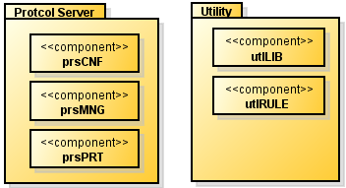
  Protocol Server and Utility Package
Protocol Server
Provides server operational means that supports network protocol.
Utility
Provides useful features to be used in the platform in common.
Component name | Abbreviation | WiseCore3 | Background and modification reason of responsibility definition
Print Server | prsPRT | prsPRT | No change.
Configuration Server | prsCNF | prsCNF | No change.
Management Server | prsMNG | prsMNG | No change.
Utility Library | utlLIB | utlLIB | Library which is only used by platform is extracted from utlLIB and newly added. Add requirements of utstmr.
Setting Rules | utlRULE | utlRULE | Condition judgment of prohibition only used by platform is extracted from utlRULE and newly added.
Notes:
Protocol Server provides server operational means that supports network protocol.
Utility package provides useful functions to be used in the platform in common.
Library which is used by Application side is placed in putLIB and putRULE in Platform Service Layer.
Next I explain about Process configuration.
Protocol Serverパッケージは、ネットワークプロトコルに対応したサーバー操作手段を提供します。
Utilityパッケージは、プラットフォーム内で使用される便利な機能を提供するパッケージです。
アプリケーション側でも使用されるUtilityは、Platform Utilityパッケージに配置されるputLIB、putRULEが提供します。
次に、プロセス構成について説明します。

